Slide 1




Introduction
April 21, 2021
Adding AI to Edge Devices
Radhika Sethi
ROLL NO - 3456
C22018221381
COMPUTER ENGINEERING
CUMMINS COLLEGE OF ENGINEERING
Eaton Pratibha Award, April 2021
R&D Head at AICVS
Co-Lead at Google's DSC
Contributing at OpenMined, HinglishNLP
Volunteer at PyData Pune, PyCon India
Wabtec Exceed 2019 Pan India Finalist
Member of MLIndia Community, 2018
Presented by
Radhika Sethi

Slide 2

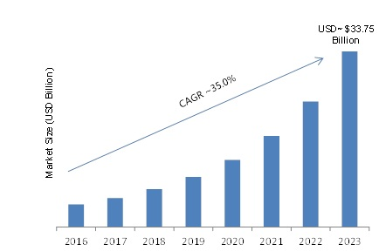

Statistics on Edge AI
Growth of AI at the Edge
According to McKinsey, AI could deliver an additional economic activity of $13T by 2030 or 16% of today’s GDP.
The business value of edge-based ML becomes obvious in the power management and electrical industries, like Eaton, where company employees work in sites far from populated areas.
Advantages of Edge-based AI
less lag time
lower bandwidth consumption
reduces data transmission costs
Precision monitoring and control
Predictive maintanence
Edge computing is set to become a $34 billion industry with the estimated growth of 35% by 2023 in comparison to the centralized data services
01
Notes:
Just last week I was attending the Nvidia GTC conference where the CEO, Jensen Huang introduced many recent inventions. One being the new hybrid cloud platform called Nvidia fleet command - an Edge solution to centralize the management of servers spread across vast areas for teams to get the most out of their AI applications.
Application:
Retailers use Deep North’s AI platform to digitize their shopping locations, analyze anonymous shopper behavior inside stores - to predict consumer behavior
Deep North uses the NVIDIA EGX platform to simplify AI deployment, and server management. With EGX, AI computations are performed at the edge entirely in stores, delivering real-time notifications to store associates for better inventory management and optimized staffing.
By optimizing its intelligent video analytics applications on NVIDIA T4 GPUs Deep North has seen orders-of-magnitude improvement in edge compute performance while delivering real-time insights to customers.
- precision monitoring and control
- predictive maintanence

Slide 3



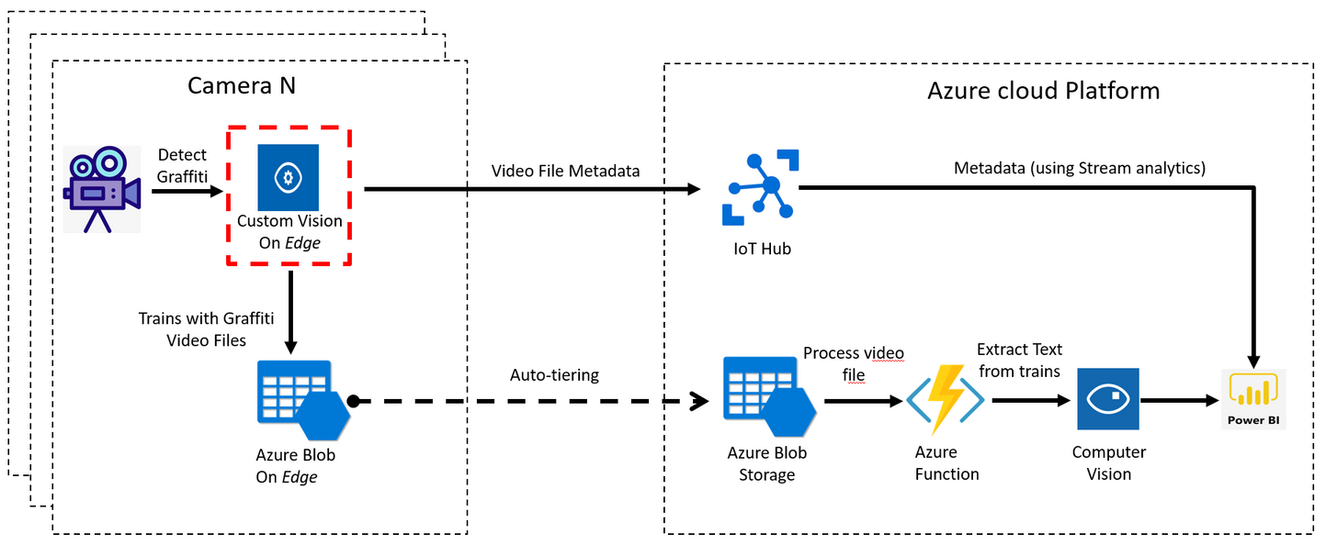
How can we transfer ML Algorithms from the cloud to the edge?
Deploying models to the edge
Example - Graffiti Detection Model trained using Azure Custom Vision, exported to an Azure IoT Hub
Transferring ML models from Cloud to Edge
Training models on the edge
We'll come to this soon!
02
Notes:
The graffiti detection model is trained using Azure Custom Vision - an image recognition service that lets you build, deploy, and improve your own image identifiers.
and is exported as a TensorFlow model to the edge (deployed as a docker container)
Edge device analyzes videos for graffiti. Only if graffiti is detected, the video is added to the storage on Edge and few are uploaded to the linked Azure Storage
- Once the video is in Azure, the video can be further processed (extract text from the video, show results on Power BI dashboard
Training models on the edge - we'll come to it shortly

Slide 4
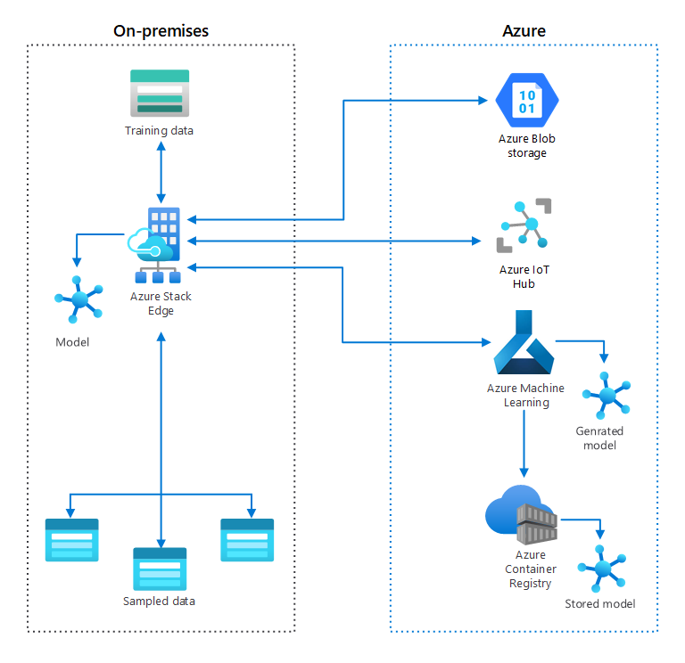
Do we have any standard frameworks to transfer algorithms?
Frameworks
Azure Stack Edge
2. Edge Device Model quickstart by GCloud
Example - Deploying on Tensorflow Lite. It is optimized for mobile phones and ARM. (Demo!)
3. AWS for the Edge
Currently in use by Phillips, Volkswagen, Cradlewise
AWS IoT Greengrass - opensource edge runtime and cloud service (IoT)
3
03
Notes:
1. azure stack edge
- Azure Stack Edge includes compute acceleration hardware - designed to improve the performance of any AI inferencing at the edge
- It helpsi in Creating long-term research solutions by using existing on premise data to generate a model. The model is then used both on-premises and in the cloud; it's retrained regularly as new data arrives.
2. edge device model quickstart - gcloud
- training is optimized for edge devices, deployed on a node, and then is exported and deployed on the edge device.
- One of the export options on GCloud is Tensorflow Lite, it is optimized for mobile phones and ARM (mobile device operating system) devices. It can further be compiled to run on Edge TPU
it can also be deployed as
a Core ML model is specially optimized for iOS apps.
3. aws for the edge
- cradlewise - uses AWS IoT to ensure its smart baby crib can keep devices operating in offline mode
- AWS IoT Greengrass is an open-source edge runtime and cloud service (IoT) that supports Amazon SageMaker Neo optimized models.

Slide 5

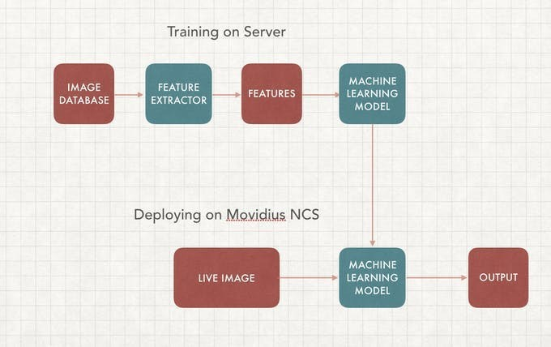
Are there any limitations?
Limitations of Transferring ML algorithms to the edge
Latency issues pertain
Transmission of data from device to cloud still pertains.
Much data is still transferred back to the cloud storage
A considerable amount of cost is involved - to train the model on the cloud, store all the data collected at the edge, onto the cloud
Deep Learning Computer Vision Model Deployment on Intel Movidus NCS -2
04
Notes:
Intel® Movidius Neural Compute Stick - vision processing unit - enables demanding edge computer vision workloads with efficiency.VPU technology enables edge servers, and computer vision-based applications in industrial automation
convert
Limitations -
- This journey from device to data center and back to device has its drawbacks. There are privacy concerns.
- Transmission of data is open to interference, and stored data leaves open the possibility of unauthorized access. But there are other significant drawbacks.
- Cloud-based AI and ML models have higher latencies, cost more to implement, lack autonomy, and, depending on the frequency of model updates, are often less personalized.
- Speeding up training is possible either by adding more resources to the device or using these resources more effectively or some combination of the two

Slide 6
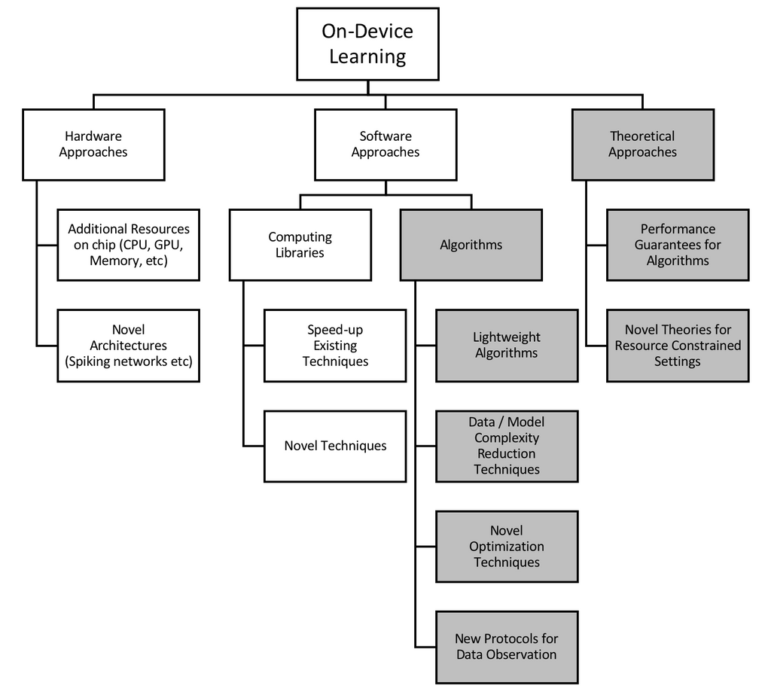
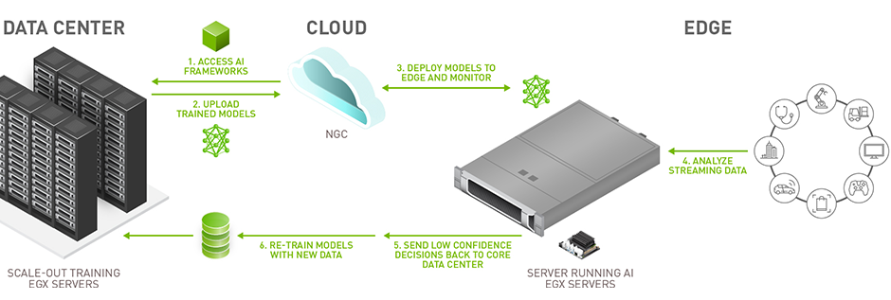
How do we train the model at the edge?
Training ML models on the edge
Optimal hardware - application-specific integrated circuits (ASICs), field-programmable gate arrays (FPGAs), RISC-based processors, and embedded graphics processing units (GPUs).
Examples of fully integrated hardware systems - Coral System-on-Module (SoM) by Google, The Intel Neural Compute Stick 2 (NCS2), ARM Ethos N-77
05
Notes:
Distributed computing - A lot of the computing power across the world goes to waste as devices remain idle. While the processing power of those devices might not be enough to perform data-intensive AI algorithms, their combined resources will be able to tackle most tasks. Blockchain, the technology that underlies cryptocurrencies, provides an interesting solution to create decentralized computers from numerous devices.
Hardware Approaches
Nvidia EGX - FUELING INNOVATION IN ENERGY
- With an NVIDIA EGX A100, one can receive up to 200 Gbps of data and send it directly to the GPU memory for AI or 5G signal processing.
- EGX A100 to process high-volume streaming data in real time from cameras and other IoT sensors to drive faster insights and higher business efficiency.

Slide 7
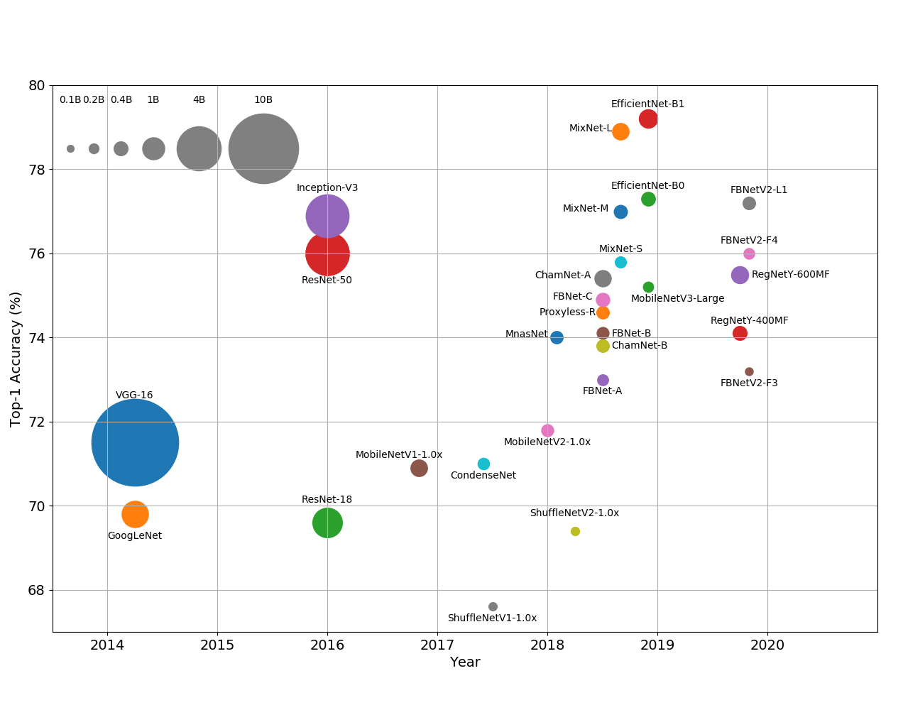
How do we train the model at the edge?
Training ML models on the edge
Reducing Model Complexity: Dominant approach for deploying resource-efficient models. there has been a slow but steady progression towards smaller, faster, leaner architectures in Deep Neural Networks
This progression has been helped by Neural Architecture Search (NAS) techniques that show a preference for smaller, more efficient networks.
06
Ball chart of the chronological evolution of model complexity. Top-1 accuracy is measured on the ImageNet dataset.
Notes:
Software Approaches
1. use lightweight ML Algorithms (linear reg/logistic reg/svm).
Drawback: lightweight ML algorithms result in models with low complexity that may fail to fully capture the underlying process resulting in underfitting and poor performance.
2. reducing model complexity :
- constraining the model architecture. this is one of the dominant approaches for deploying resource efficient models. This approach extends to even Deep Neural Networks (DNNs) where there has been a slow but steady progression towards smaller, faster, leaner architectures.
3. modifying optimization routines:
Resource-constrained model-centric optimization routines focus on improving the performance of models that will be quantized after training either through stochastic rounding, weight initialization
4. Data Compression:
: Rather than constraining the model size/complexity, data compression approaches target building models on compressed data. The goal is to limit the memory usage via reduced data storage and computation through fixed per-sample computation cost.

Slide 8
Are there any limitations?
Limitations of training ML algorithms on the edge
The need to decouple algorithms from the hardware and design effective loss functions.
Improved methods for model profiling are needed to more accurately calculate an algorithm’s resource consumption.
Our everyday devices are often multi-tasking. Taking this changing resource landscape into account is an important challenge for effective model training on the edge.
There is a need for resource-efficient model building
07
Notes:
Every machine learning algorithm depends on a set of computing libraries for efficient execution of a few key operations (such as Multiply-Add in the case of neural networks). The libraries are the interface between the hardware and the algorithms. However, these libraries are heavily tuned to the unique aspects of the hardware on which the operations are executed. This dependency limits the amount of improvement.
- There are a number of challenges before we can consistently train models on the edge including the need for decoupling algorithms from the hardware and designing effective loss functions and metrics that capture resource constraints.
- static budgets being a problem, we can expand our focus on traditional as well as advanced ML algorithms with low sample complexity to deal with such situations

Slide 9
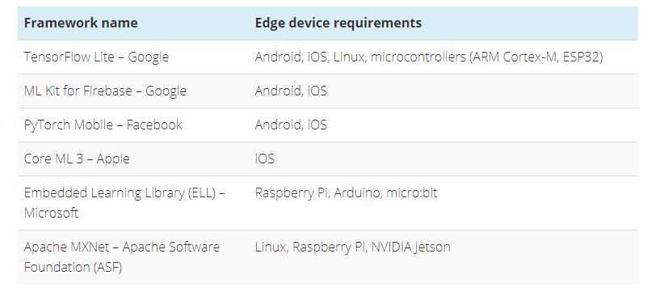
Popular ML Frameworks that run on edge devices
ML Frameworks for IoT Edge Devices
08

Slide 10
Summary
Summary
If AI is the Spaceship then Data is the Rocket Fuel
Designing power-efficient ML algorithms, developing better-specialized hardware, and inventing new distributed-learning algorithms where all IoT devices communicate and share data.
Devices can be truly powerful once we sever the lifeline that extends between the device and the cloud. That requires the ability to train machine learning models on devices itself.
Future 5G networks, which provide ultra-reliable, low-latency communication services, will help immensely in the domain
Development of algorithms that can train models under resource constraints will be a game-changer.
09
Notes:
2. Training ML models on a device has so far remained an academic pursuit, In the industry, this interest is fueled mainly by hardware manufacturers promoting AI-specific chipsets that are optimized for certain mathematical operations, and startups providing ad hoc solutions to certain niche domains mostly in computer vision and IoT. From an AI/ML perspective, most of the activity lies in two areas — the development of algorithms that can train models under resource constraints and the development of theoretical frameworks that provide guarantees about the performance of such algorithms.

Slide 11
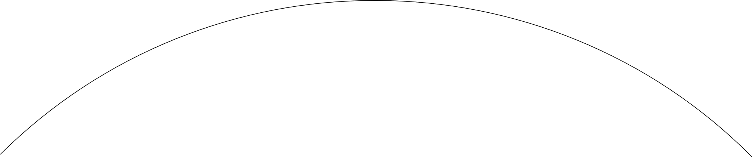



My take on Edge AI - Deploying ML to an edge device
In service-based industries such as the finance and e-commerce sector, edge computing devices also have roles to play. In this case, a smart phone, laptop, or tablet becomes the edge computing device.
Accelerating the inference by delegating local GPU to the application
Set up an android application to run the trained model on an android app
Deploy the model on a phone! (Edge device)
Trained a flower classifier, object detection model on Google Colab as a tflite model
Test the model, while realizing the resource restrictions
Taking applications to the edge
latency : 90ms
latency : 110ms
10
Thank You!

